Slide 1
PBD-02-001
PSC INSPECTIONS
PARTNER.SHIP.REDEFINED.
PSC MOST COMMON ISSUES
PREPARATION FOR INSPECTION
MLC PROBLEMATIC ITEMS
PDB-02-001

Slide 2
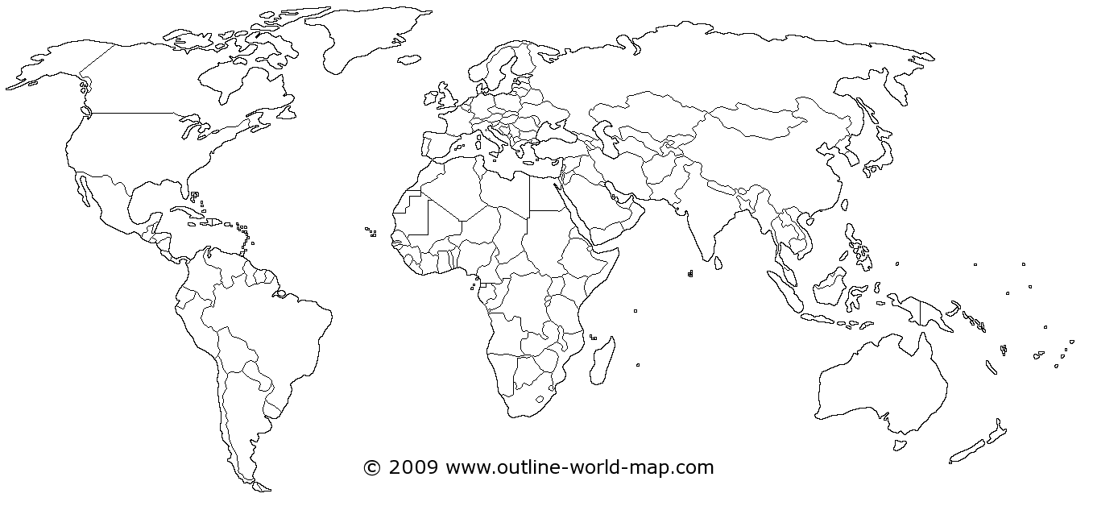
PSC INSPECTIONS
TOP 3 CATEGORIES OF DEFICIENCIES – 2019 REPORT
PARIS MOU
1. Fire Safety
2. Safety of Navigation
3. Life-saving Appliances
BLACK SEA MOU
TOKYO MOU
1. Safety of Navigation
2. Life-saving Appliances
3. Fire Safety
1. Life-saving Appliances
2. ISM
3. Fire Safety
US COAST GUARD
1. ISM
2. Fire Safety
3. MARPOL Annex I
INDIAN OCEAN MOU
1. Fire Safety
2. Safety of Navigation
3. Life-saving Appliances
AMSA
1. ISM
2. Fire Safety
3. Emergency Systems

Slide 3
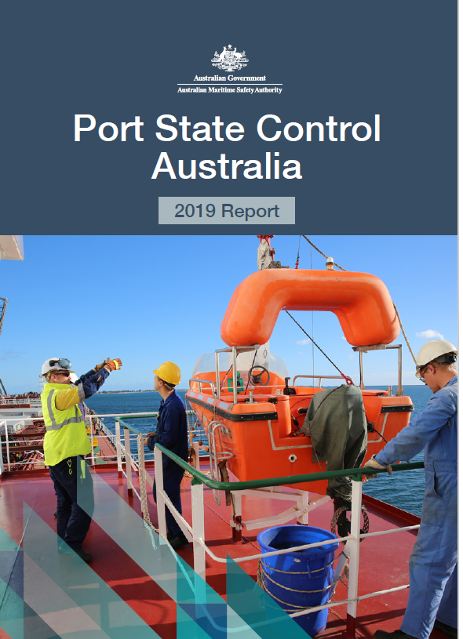
PSC INSPECTIONS
AMSA
2019 PSC inspection results saw an ongoing reduction in the detention rate of vessels to 5.1 per cent from 5.5 per cent in 2018 and down from a peak of 9.2 per cent in 2011. This is the lowest detention rate since 2006.
However, as observed in past PSC annual reports, the most frequent cause of detention since 2010 still relates to ineffective implementation of the safety management system required by the International Safety Management (ISM) Code.
Since 2015, issues concerning passage planning, conduct of voyages and the operation of vessels have contributed significantly to the number of ISM detentions and this remains a significant concern for AMSA. To address this AMSA issued a marine notice MN 2019/02 (Responsible navigational practices), in 2019 with a view to highlighting issues associated with navigational practices.
Since 2014, the same material issues have featured in the top five categories for detention. This was repeated in 2019 with fire safety (17.4%), emergency systems (16.5%) and life-saving appliances (14.7%). Pollution prevention (11.5%) was among the top five categories of detainable deficiencies for the second consecutive year.

Slide 4
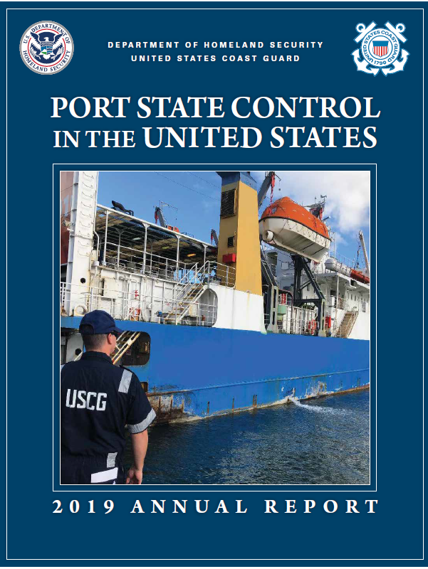
PSC INSPECTIONS
US COAST GUARD
In 2019, the number of detentions have decreased compared to the previous year. Nonetheless, the most notable causes of deficiencies are related to the following:
1. Failure to implement the safety management system (SMS).
2. Fire prevention concerns. 16 detainable deficiencies were identified related to accumulation of oil in the engine room such as fuel leaks, oil-soaked lagging and excessive amounts of oil in the bilges.
Although only a small percentage of deficiencies (9%) were MARPOL Annex I related, it has to be emphasized that the most common cases were related to oily water separators not being able to produce an effluent below 15ppm.

Slide 5
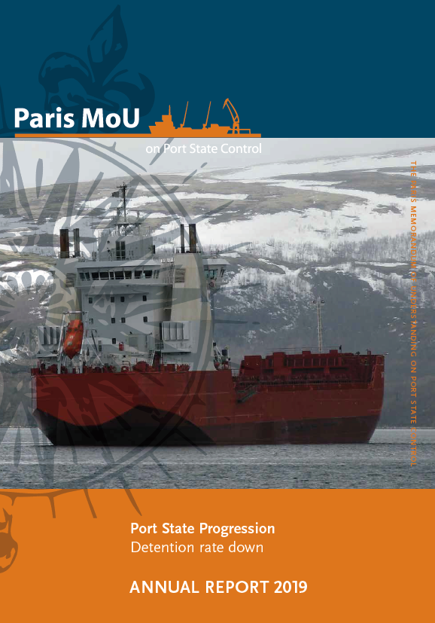
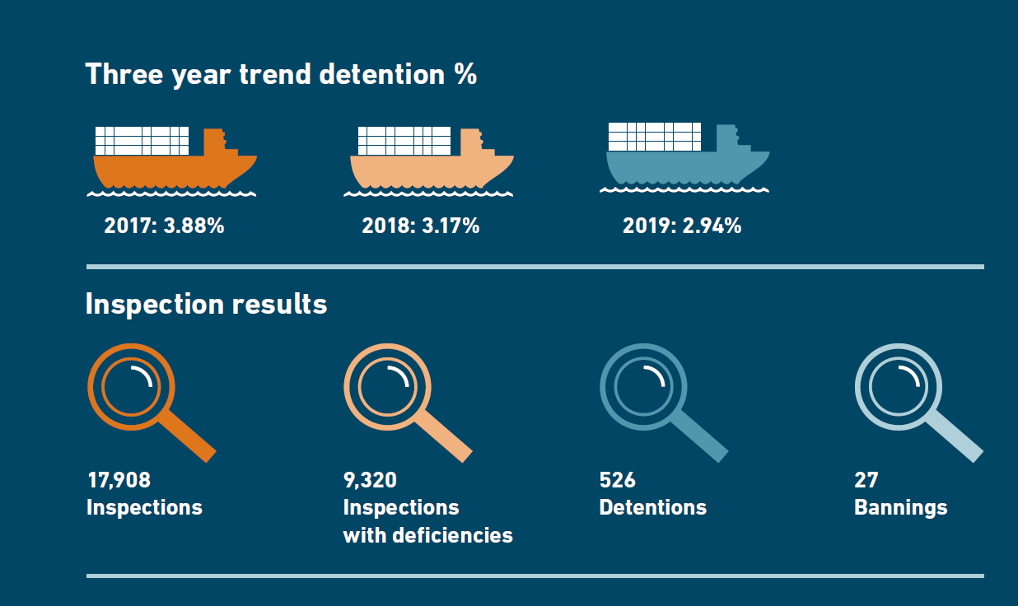
PSC INSPECTIONS
PARIS MOU

Slide 6
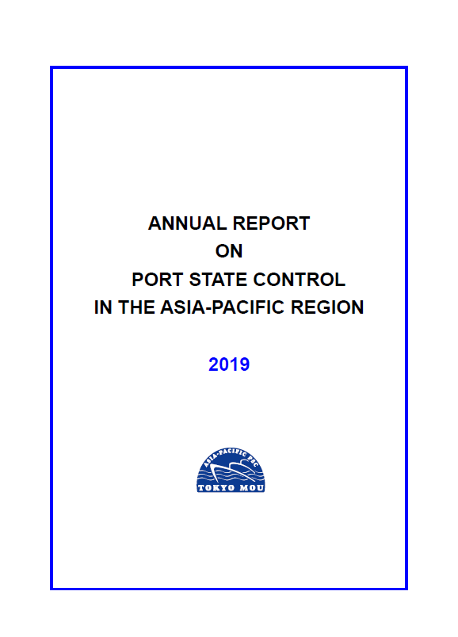
PSC INSPECTIONS
TOKYO MOU
It is noted that both number of detentions and detention percentage increased in 2019, after respective seven years’ and ten years’ continuous decrease. It is further observed that the number of under-performing ships published and number of individual ships involved also rose in 2019.
ISM related detainable deficiencies have remained in the top three detainable deficiency categories for several years.
One third of all detentions are on the grounds of a major non-compliance with ISM reflecting the importance of ISM to the effective operation of ships.

Slide 7
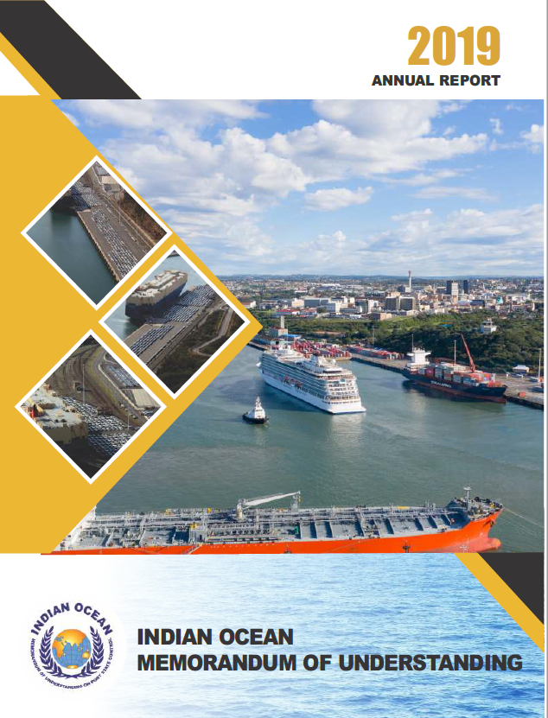
PSC INSPECTIONS
INDIAN OCEAN MOU
The average number of deficiencies per inspection in 2019 (1.84) has slightly decreased compared to the previous year (2.07).
Despite the decrease, majority of the 2019 deficiencies remain to be related to fire safety, safety of navigation and life-saving appliances.

Slide 8
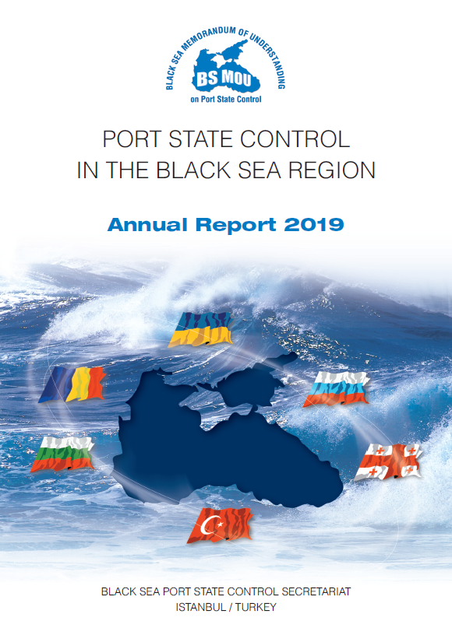
PSC INSPECTIONS
BLACK SEA MOU
The most significant number of operational deficiencies found in 2019 was in the area of safety of navigation, life saving appliances followed by health protection, medical care, social security followed by fire safety measures and structural conditions which constitutes 56.3% of the total deficiencies found.

Slide 9
PSC INSPECTIONS
FINDINGS EXAMPLES
Gangway is not provided with safety net
Improper stowage and securing of oxy/acetylene tanks

Slide 10
PSC INSPECTIONS
FINDINGS EXAMPLES
Navigation light cover was painted over
Missing securing bolts / butterfly nut for ventilation cover, vent cover welded to structure and corroded handrails

Slide 11
PSC INSPECTIONS
FINDINGS EXAMPLES
Flooded emergency pump room
Oily rags placed around the engine (fire hazard)

Slide 12
PSC INSPECTIONS
FINDINGS EXAMPLES
Oil around engine machinery / poor housekeeping
Corroded/damaged ballast vent head cover

Slide 13
PSC INSPECTIONS
FINDINGS EXAMPLES
Garbage bags stored under the engine room gratings
Oil on engine room flooring

Slide 14
PSC INSPECTIONS
FINDINGS EXAMPLES
Corrosion due to leaking machinery pump and illegal drip pan/bucket underneath
Telephone handset not properly secured. Damaged holder

Slide 15
PSC INSPECTIONS
FINDINGS EXAMPLES
Hole on the accommodation structure
Filthy / sub-standard cabin

Slide 16
PSC INSPECTIONS
FINDINGS EXAMPLES
Damaged toilet flush tank
Rotten vegetables

Slide 17
PSC INSPECTIONS
Preparation for Inspections
1. First impression counts!
Mooring lines and gangway arrangements, security check on boarding, notification of the ship’s command, pick up at the access point and impression of vessel’s condition on the way to the master’s cabin.
2. Vessel’s topside, galley, cabins, stores, cargo office, engine room and all other areas must be clean and orderly.
3. Records must be organized and readily available.
4. Crew must be adequately familiarized with emergency procedures/drills. A common deficiency. When conducting the drills regularly and properly, crew may become aware of damaged or inoperable life-saving or fire-fighting equipment.

Slide 18
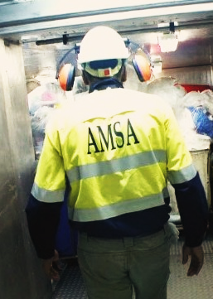
PSC INSPECTIONS
Common Practice during Inspections
Meet the PSC inspectors at embarkation, ask for I.D. and escort them to the Master’s office. Request for an opening meeting. Ask for clarifications if necessary.
Introduce the key officers, who will escort the PSC inspectors in each areas. If they are on duty, it must be mentioned to the PSC inspectors.
The key officers must be professional and must keep notes of any identified deficiencies. If possible notify command immediately of identified deficiencies and initiate corrective actions on the spot.
The ship’s command must clarify potentially unjustified deficiencies and detentions BEFORE signing the inspection report. Diplomacy and cultural awareness are required, in order to ensure positive outcome.
For potential major deficiencies and/or detention notify the company immediately and still during the ongoing inspection.
Request for a closing meeting. Ensure the content of the report by directly inquiring if there is nothing that suggest a detention. Escort the PSC inspectors until disembarkation.

Slide 19

MLC INSPECTIONS
S.E.A Contract Extensions
For short contact extensions a new SEA print out is not always required. This should be pointed out to inspectors
POEA Section 19
ITF Ver.di CBA (Annex 1)
Marlow Standard Terms & Conditions
POEA Section 19:
If the ship is outside the Philippines upon the expiration of the contract, the seafarer shall continue his service on board until the ship’s arrival at a convenient port and/or after arrival of the replacement crew provided that, in any case, the continuance of such service shall not exceed three months. The seafarer shall be entitled to earned wages and benefits as provided in his contract.
ITF Ver.di CBA (Annex 1):
Duration of Employment
The maximum period of engagement to in Article 5 shall be nine (9) months, which may be extended to 10 months or reduced to eight (8) months for operational convenience.
Marlow Standard Terms & Conditions:
Article 5: Duration of Employment
5.1 A seafarer shall be engaged for a period of 9 (nine) months for both officers and ratings or as otherwise mutually agreed and such period may be extended or reduced by one month for operational convenience in Company’s option. The employment shall be automatically terminated upon the terms of this Agreement at the first arrival of the ship in port after expiration of that period, unless the Company operates a permanent employment system.
This information is also available in the Marlow Vessel Portal, Under PSC inspections section.
!
In case of questions, please contact your agency.

Slide 20
THANK YOU!

